Slide 1



Introduction
With TimeCard for Outlook appointments are tagged with information that converts them into time sheets. This way users can report time and expenses from their Outlook calendars. When they also plan their time in Outlook there will be no double entries.
The tagged appointments will be reported to an Access or SQL Server database.
At reporting, users can also export each time report to an Excel datasheet.
Reported time can be analysed in Excel statistics reports.
In the first part of the presentation, I will show you how users can work with TimeCard. After that we will take a look at the TimeCard settings and then finally study the TimeCard statistics.
www.bizsolutions365.com
TimeCard Workgroup supports Microsoft Office 2010 and above

Slide 2

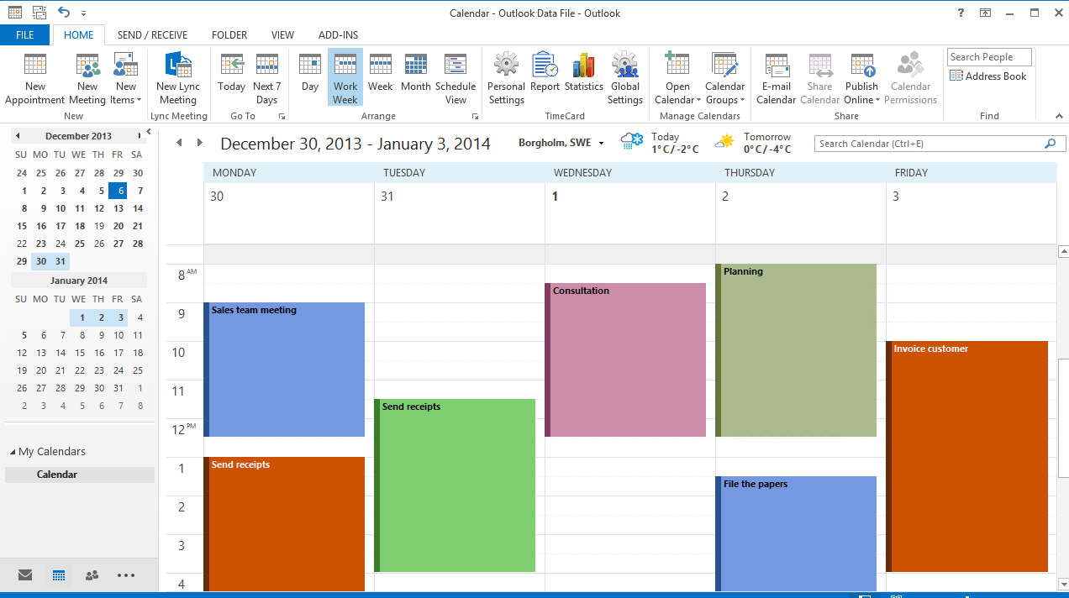
TimeCard is fully integrated in Outlook
The TimeCard buttons for Settings, Time reporting and Statistics. This is from an admin installation, so the Global Settings button is shown.
www.bizsolutions365.com
TimeCard Workgroup supports Microsoft Office 2010 and above

Slide 3
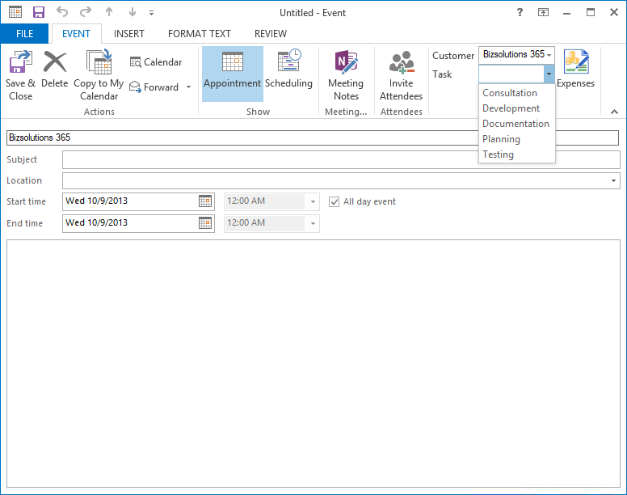
Tag appointments with time reporting data
Users work with the appointment as they normally would, but they also select 1-3 values with time reporting data.
All info in the appointment will be transferred to the database.
Tag each appointment by selecting a value from the dropdown.
By default the TimeCard tags are Customer and Task, but the administrator can easily change them into other parameters in the Global Settings.
www.bizsolutions365.com
TimeCard Workgroup supports Microsoft Office 2010 and above

Slide 4
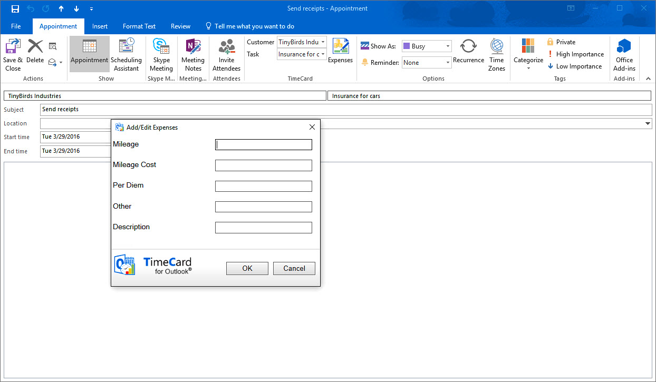
Add expenses to appointments
Press the Expenses button to add expenses to the appointment. These will be entered into the database when the appointment is reported.
The Expenses feature must be enabled by the administrator in the TimeCard Global Settings.
In the TimeCard settings, the admin can decide what labels should be used in the Add/Edit Expenses dialog.
www.bizsolutions365.com
TimeCard Workgroup supports Microsoft Office 2010 and above

Slide 5

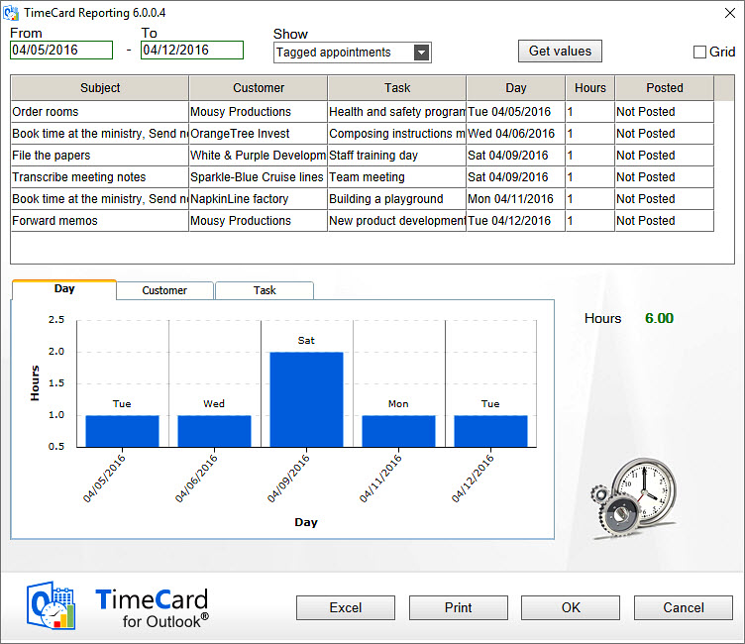
Report time from the Outlook Calendar
Select period for the report.
Review the appointments before you post your report.
Mistakes are easily corrected, and all changes are reflected back to the calendar.
Select how you want to show graphs for the period.
Export to an editable Excel sheet
www.bizsolutions365.com
TimeCard Workgroup supports Microsoft Office 2010 and above

Slide 6
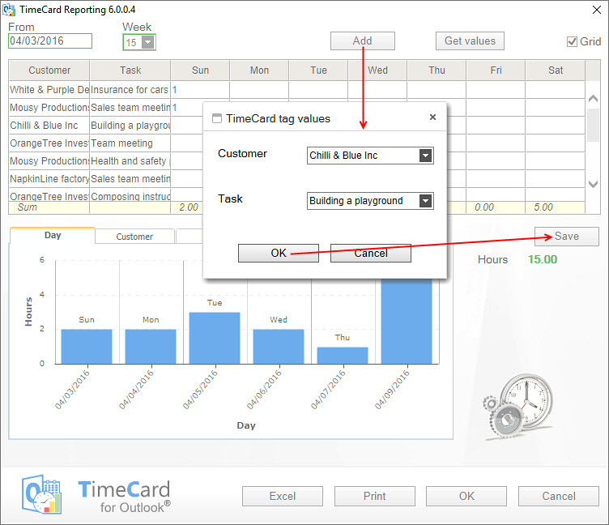
Report time from the Outlook Calendar - Grid
The grid view lets users enter time directly in the reporting screen
Add a new appointment
Save the new appointment to the calendar
www.bizsolutions365.com
TimeCard Workgroup supports Microsoft Office 2010 and above

Slide 7
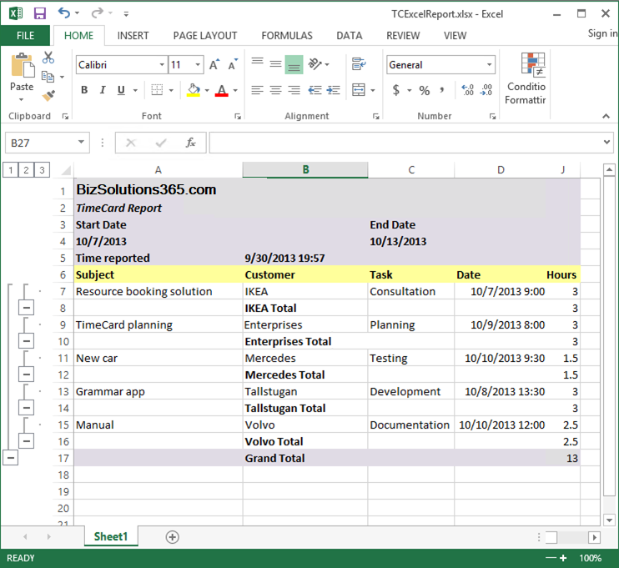
Export the report to Excel
Report data may be exported to an editable Excel sheet. This is useful when a manager must approve of the report before reporting.
Hours are grouped by one of the tasks and summarized.
When the Expenses feature is enabled expenses are summarized too.
www.bizsolutions365.com
TimeCard Workgroup supports Microsoft Office 2010 and above

Slide 8
Installation
You may install TimeCard in two ways:
as an administrator, with the file TimeCardAdminSetup.msi.
The administrator defines
  where settings should be saved and reports should be sent
  how costs should be calculated
  what TimeCard properties (tag, tag values, tag types and tag categories) should be used within the organization
  and much more.
An organization may have several administrators, who all have access to the Global Settings.
as a user, with the file TimeCardUserSetup.msi.
Users connect to the database and the TimeCard tags and tag values.
The same file may be used for a central installation on the clients via Active Directory.
Let’s first look at the administrator settings!
www.bizsolutions365.com
TimeCard Workgroup supports Microsoft Office 2010 and above

Slide 9

Global Settings
Administrators can reach the Global Settings by the Global Settings button in the TimeCard ribbon group or by running the file TCCommonSettings.exe in the TimeCard Workgroup folder under Program files.
Only administrators, who have installed TimeCard using the file TimeCardWorkGroupSetup.msi, will have this .exe file and button.
The TimeCard Global Settings have one main screen and four other screens for different kinds of settings.
Let’s continue!
www.bizsolutions365.com
TimeCard Workgroup supports Microsoft Office 2010 and above

Slide 10
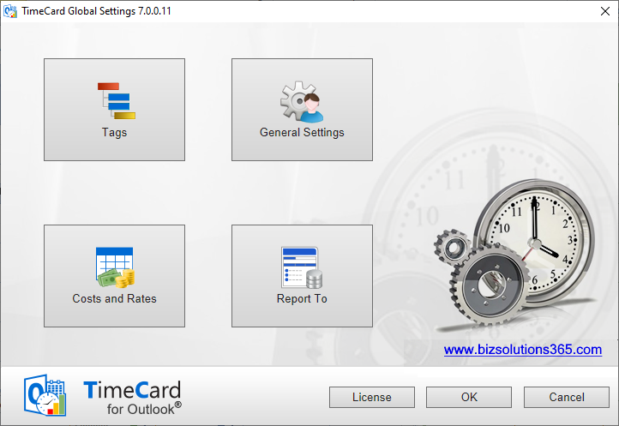
Global Settings, main screen
In the Global Settings the administrator defines common settings and TimeCard properties
This button will be hidden once TimeCard has been registered.
www.bizsolutions365.com
TimeCard Workgroup supports Microsoft Office 2010 and above

Slide 11
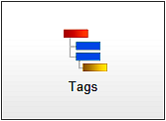
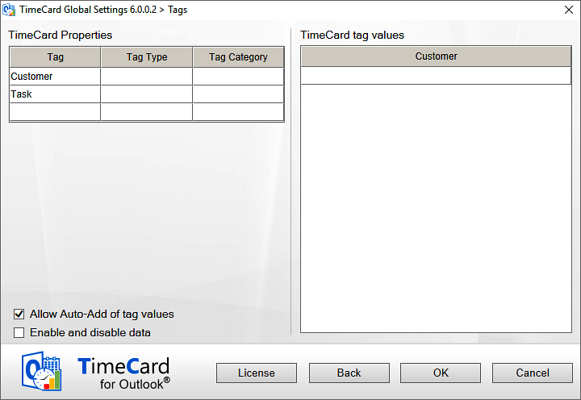
Tags settings, default screen
Define1-3 parameters to tag appointments with
Define what tag values users should be able to select from in the appointments.
Check this box if you want a possibility to hide tag values from the users. Then users cannot select this value anymore and not report on it, but you will still see it in the database and statistics.
www.bizsolutions365.com
TimeCard Workgroup supports Microsoft Office 2010 and above

Slide 12
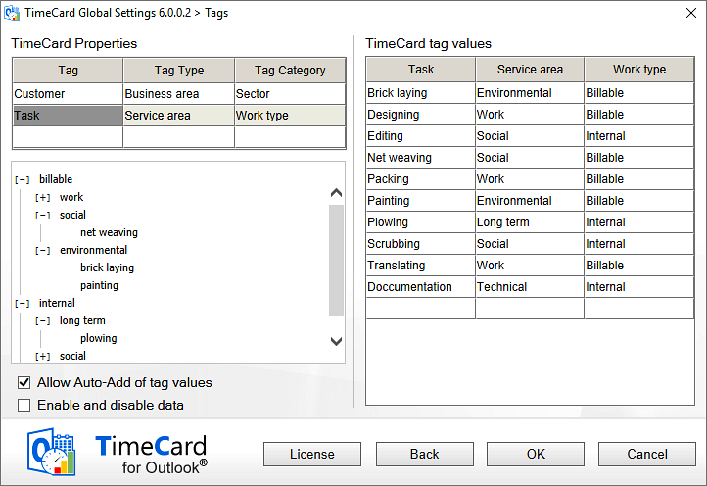
Tags settings with example data
Write or paste in the values.
Use Type and Category if you want to group the tag values in the statistics.
A tree shows the hierarchy when you use Type and Category
www.bizsolutions365.com
TimeCard Workgroup supports Microsoft Office 2010 and above

Slide 13
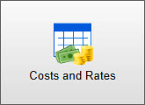
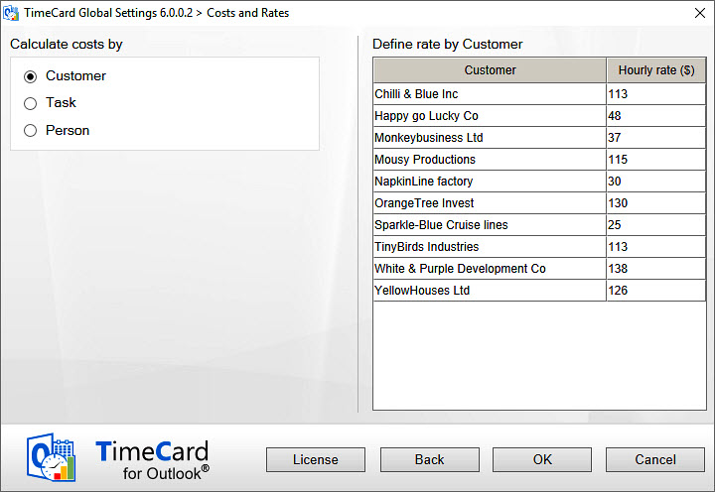
Costa and Rates settings
Select what tag to calculate costs by. If the admin has entered other tags than Customer and Task they will be shown here instead.
Costs may also be calculated by Person, and then the rate may be given by the administrator or by each user
The tag values specified in the Tags screen will show up here, and the admin just have to enter the rate. The currency will be the one of the admin system.
www.bizsolutions365.com
TimeCard Workgroup supports Microsoft Office 2010 and above

Slide 14
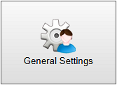
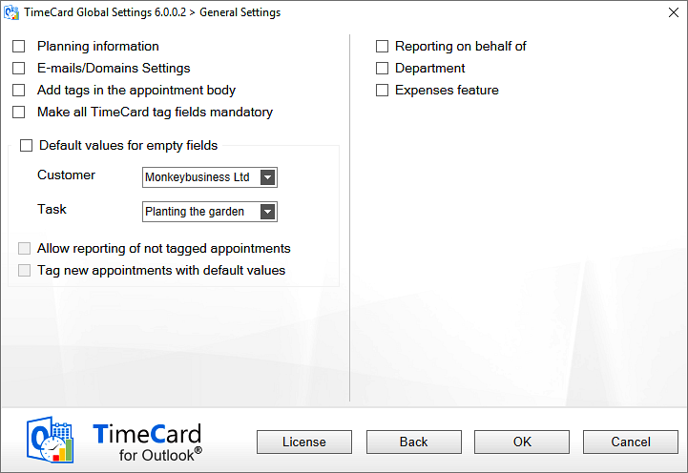
General settings
Include future appointment in the reports
Make it possible for a person to report on behalf of someone else and still get the correct name on the report
Check the Expenses box if you want to users to be able to report expenses with the appointments. It is possible to use five different fields for the expenses.
Set TimeCard to use certain tag values if users have left fields empty in the appointment.
www.bizsolutions365.com
TimeCard Workgroup supports Microsoft Office 2010 and above

Slide 15
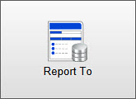
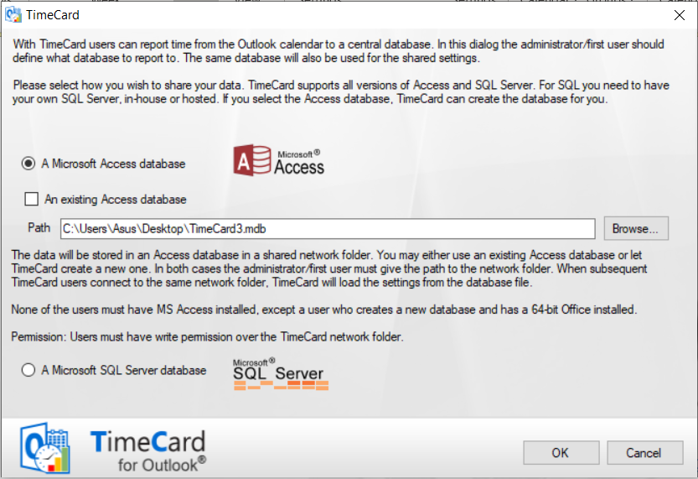
“Report TO” settings
Decide what database or MS Access or SQL for reporting and shared data.
This dialog is also shown automatically after the admin has installed TimeCard.
www.bizsolutions365.com
TimeCard Workgroup supports Microsoft Office 2010 and above

Slide 16

Personal Settings
In the TimeCard Personal Settings each user decides what tag values should be displayed in the TimeCard appointment dropdowns, what appointments should be included in reports and more.
When TimeCard is installed with the file TimeCardClientSetup.msi the user gets the first ribbon group, with only Personal Settings.
For administrators, buttons for both the Personal and the Global settings are displayed.
Let’s have a look at the Personal Settings!
www.bizsolutions365.com
TimeCard Workgroup supports Microsoft Office 2010 and above

Slide 17
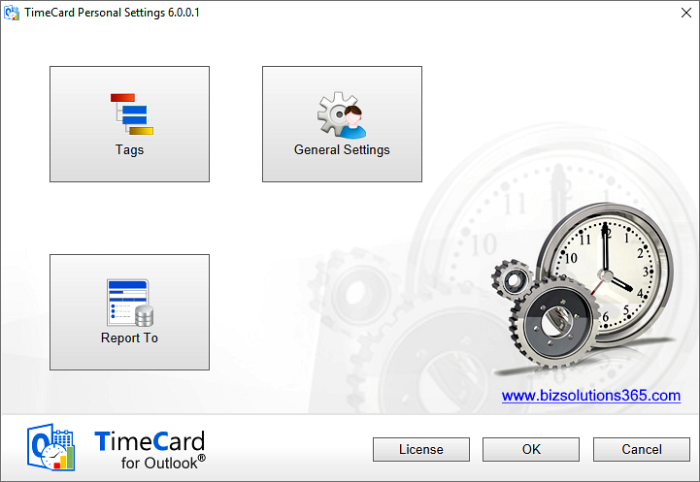
Personal Settings, main screen
TimeCard can be registered by anyone for the whole workgroup. No special permissions are necessary.
www.bizsolutions365.com
TimeCard Workgroup supports Microsoft Office 2010 and above

Slide 18
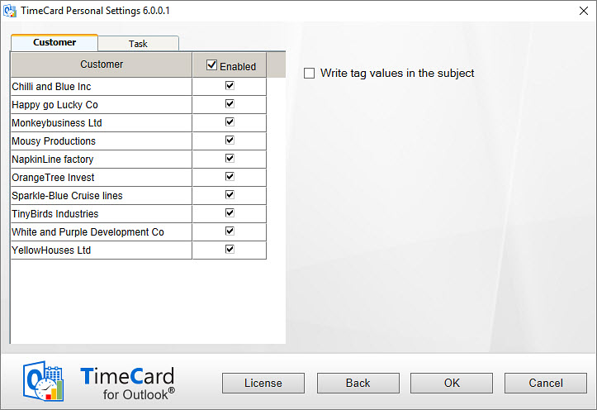
Personal Settings, “Tags” screen
Check this box to have tag values added to the appointment subject
Tags and tag values specified by the TimeCard administrator will be displayed here. The values this user select, will be shown in his/her appointment dropdowns.
This way users only have to choose among values they really need.
www.bizsolutions365.com
TimeCard Workgroup supports Microsoft Office 2010 and above

Slide 19
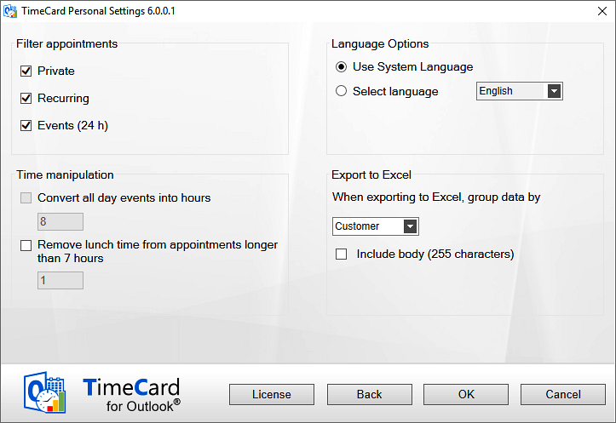
Personal Settings, “General Settings” screen
Users can filter out appointments from the reporting, so that they can use the TimeCard calendar for various purposes.
Select language for reporting and shared settings.
Settings for the Excel export that is possible at each reporting period
www.bizsolutions365.com
TimeCard Workgroup supports Microsoft Office 2010 and above

Slide 20
Personal Settings, “Report to” screen
This screen will be shown after each user’s first installation, for selection of the TimeCard database. This may also be done via AD.
The screen will also be shown automatically if the database, and users can open the screen and change database manually, for example after change of department.
www.bizsolutions365.com
TimeCard Workgroup supports Microsoft Office 2010 and above

Slide 21


Statistics
When users have reported for some time the data can be studied in statistics reports. Each user may see his/her own statistics, and the administrator and management can see statistics for all users.
The statistics are shown in an Excel file, and all the standard Excel features can be used with the TimeCard statistics.
The TimeCard statistics have three default reports per tag. When the Expenses feature has been enabled there will be one additional expenses report per tag.
It is also possible to create custom reports from the data in the TimeCard database.
Let’s look at the last part!
www.bizsolutions365.com
TimeCard Workgroup supports Microsoft Office 2010 and above

Slide 22
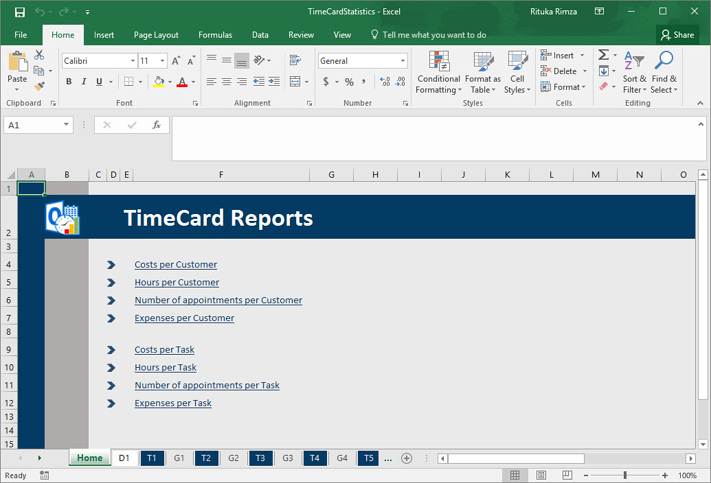
Statistics Home
Each of the statistics reports has a pivot and a graphic representation.
www.bizsolutions365.com
TimeCard Workgroup supports Microsoft Office 2010 and above

Slide 23
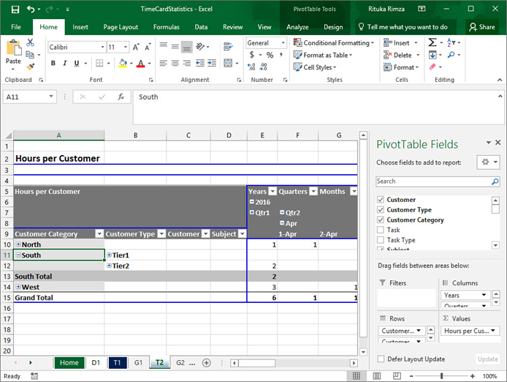
Pivot representation
Drill into the data to see more details by clicking the + signs
www.bizsolutions365.com
TimeCard Workgroup supports Microsoft Office 2010 and above

Slide 24
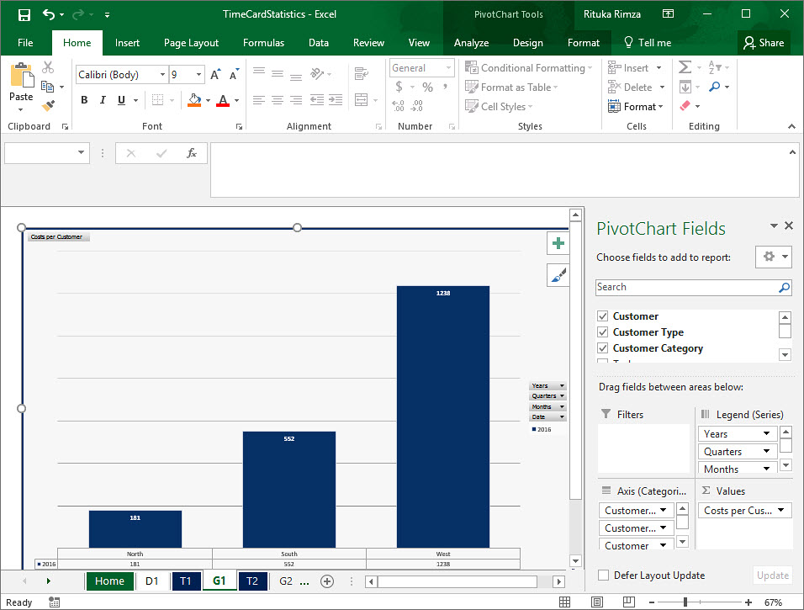
Graphic representation
Use the Excel tools to create any presentations you wish
www.bizsolutions365.com
TimeCard Workgroup supports Microsoft Office 2010 and above

Slide 25
More info
Thank you for watching this slide show!
You will find more information about TimeCard at https://bizsolutions365.com/our-products/timecard/timecard-workgroup/. There you can download the full version of the software and evaluate it for 30 days before you decide if you want to subscribe to it.
On the website you can also find a detailed manual, video demonstrations of TimeCard and information about subscription levels and support.
www.bizsolutions365.com
TimeCard Workgroup supports Microsoft Office 2010 and above

