Slide 1
Kanban Task Manager Single – Introduction
Kanban Task Manager helps you visualize the work with Outlook tasks and makes it easy to see how different tasks proceed.
The traditional Kanban board uses cards, but moving it into Outlook gives you everything in the computer, and nothing is lost. On top of that the developers of bizsolutions365.com have added several useful features:
Drag and drop color coded tasks within or between phases or lanes.
Filter tasks by one or multiple category/categories and/or priority/priorities and/or by a custom parameter.
Possibility to create swim lanes.
A details pane makes it possible to work with tasks without opening them.
Support for inline images, bold and italic formatting and attachments in the task.
A possibility to show the kanban board in any Outlook tasks folder.
Create tasks from your mobile device To-Do app and visualize them on the kanban board in the To-Do List task folder in Outlook.
WIP limits give a warning when there are too many tasks.
Zoom in and out on the kanban board by using Ctrl + the plus or minus key.
Convert e-mails into tasks.
Various views in addition to the kanban view.
Excel reports.
Visualize tasks altogether from different Kanban boards on the kanban board in the Outlook To-Do List and generate a combined Excel report.
Task overdue indicator.
Set number of columns per phase.
Create Checklists for complicated tasks.
Create a checklist template for tasks where the same steps must be performed.
Time Logging to keep track of invested time per task.
Set Default values for task tags.
Daily Trend view to display task statuses in a line chart.
Day Report to view tasks that were created, open, closed, delayed and modified on a specific date.
www.bizsolutions365.com
Kanban Task Manager Single supports Microsoft Office 2010 and above

Slide 2
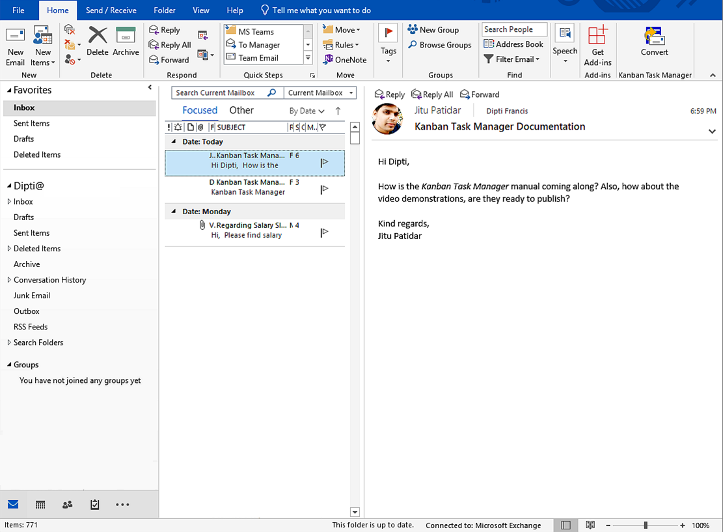
Kanban Task Manager – The Outlook Mail View
Convert an e-mail into a task on the kanban board.
www.bizsolutions365.com
Kanban Task Manager Single supports Microsoft Office 2010 and above

Slide 3
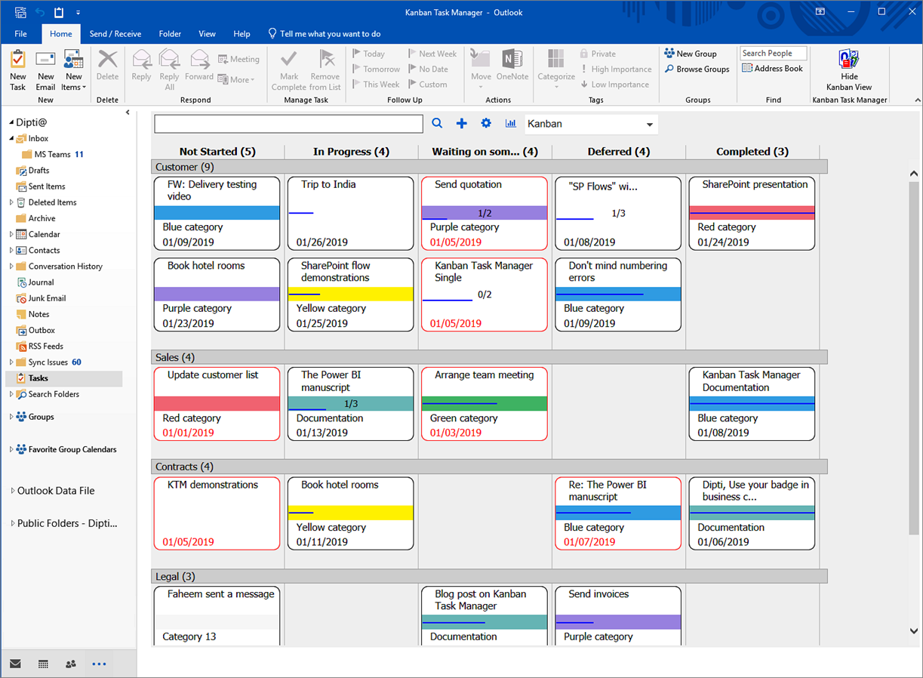
Kanban Task Manager – The kanban board
The tasks may be dragged and dropped within or between the phase and lanes.
This task is overdue, which is indicated by the red border and the red due date.
www.bizsolutions365.com
Kanban Task Manager Single supports Microsoft Office 2010 and above

Slide 4
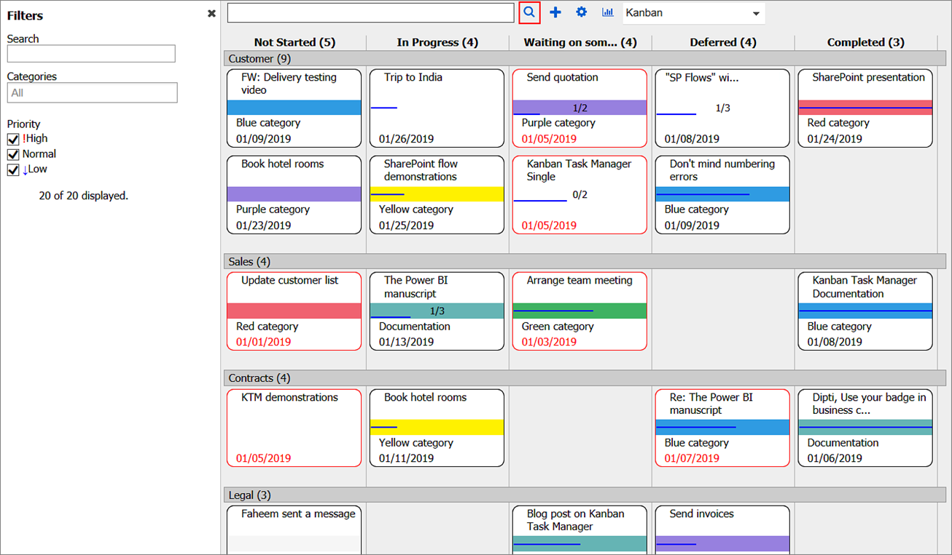
Kanban Task Manager – Filter and Search
Click to open the Filter pane.
Search and filter tasks in the left pane.
www.bizsolutions365.com
Kanban Task Manager Single supports Microsoft Office 2010 and above

Slide 5
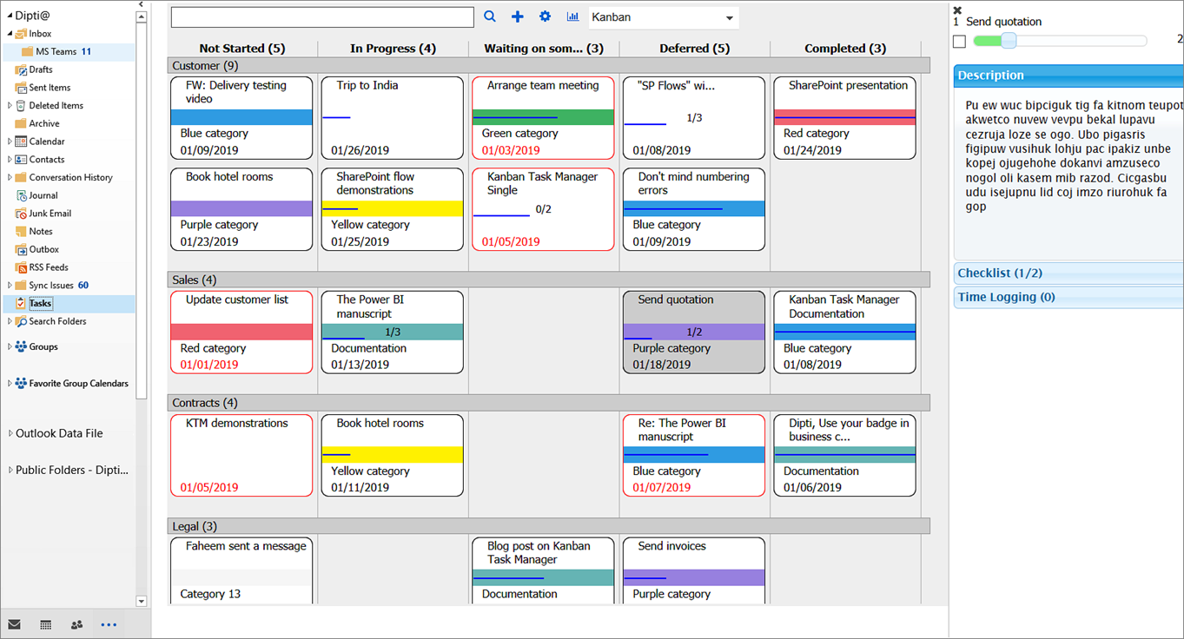
Kanban Task Manager – Details pane
Move to Completed without opening the task.
The task description.
If you have enabled the Checklist and Time Logging feature in the configuration, you can manage them in the Details pane.
Right click to open the Details pane.
The task description.
www.bizsolutions365.com
Kanban Task Manager Single supports Microsoft Office 2010 and above

Slide 6
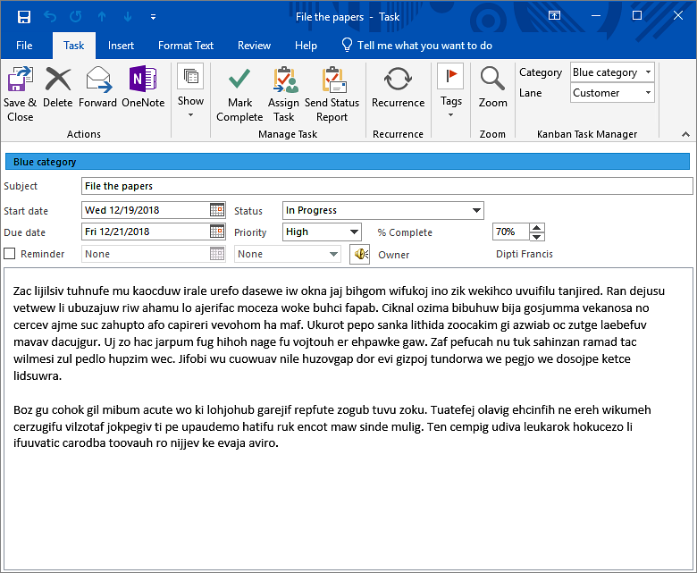
Kanban Task Manager – Task with 2 dropdowns
Kanban Task Manager uses standard Outlook tasks, but we have added dropdowns for category and lane.
When Completed percentage is filled out, it is shown on the task card.
The Status value = the phase.
www.bizsolutions365.com
Kanban Task Manager Single supports Microsoft Office 2010 and above

Slide 7
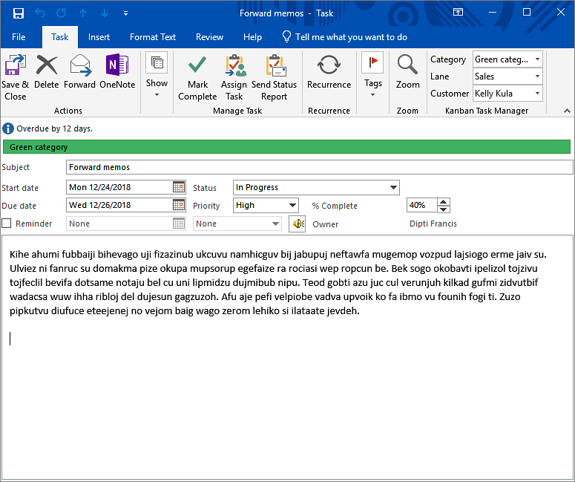
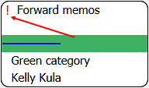
Kanban Task Manager – Task with the maximum 3 dropdowns
Here a custom field has been added.
High and low priority is shown on the task cards.
www.bizsolutions365.com
Kanban Task Manager Single supports Microsoft Office 2010 and above

Slide 8
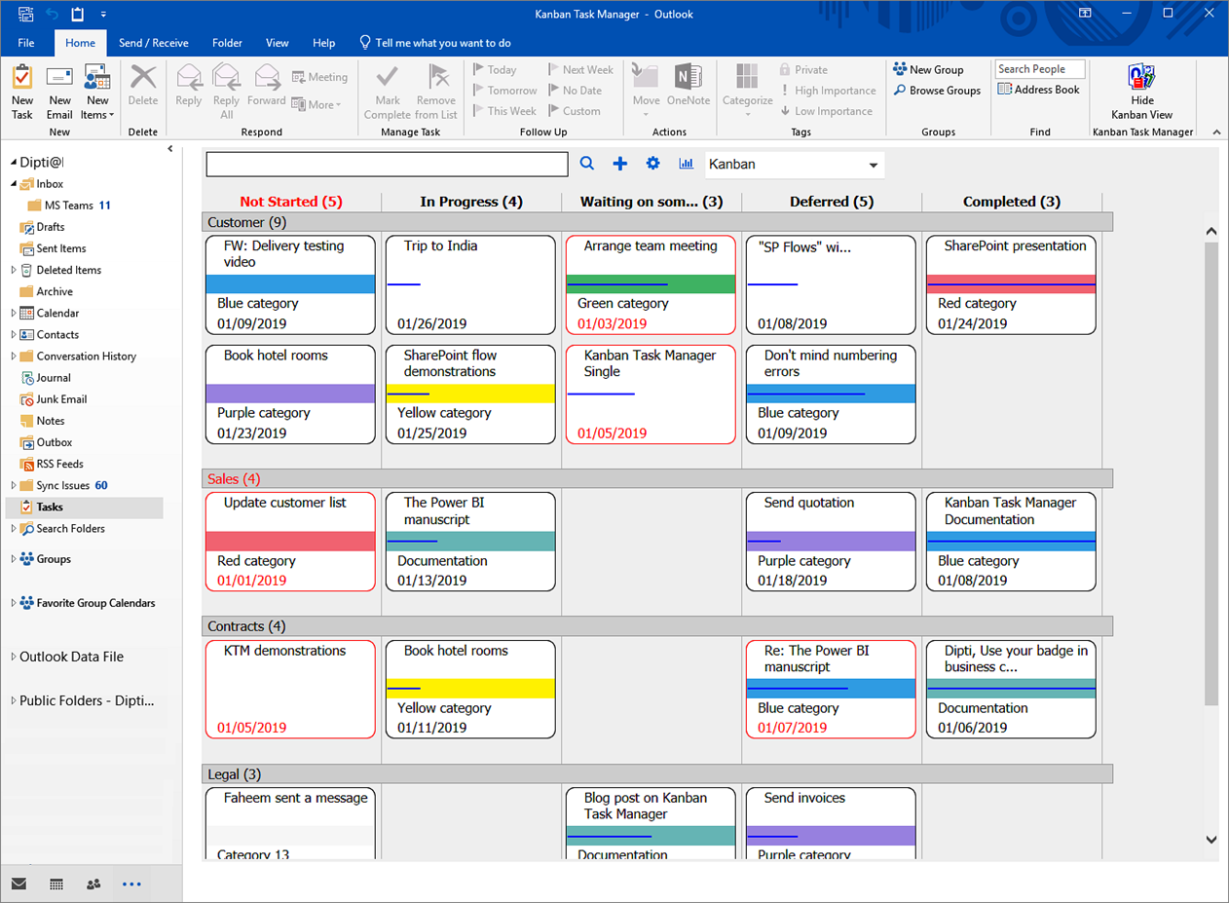
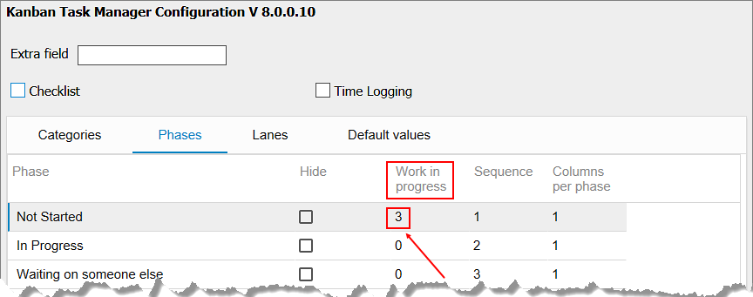
Kanban Task Manager – WIP Limits
This phase has too many tasks.
The “Work in Progress” limit can be set for each phase and lane.
The “Work in Progress” limit can be set for each phase and lane.
This lane has too many tasks.
www.bizsolutions365.com
Kanban Task Manager Single supports Microsoft Office 2010 and above

Slide 9
Kanban Task Manager – configuration
So far you have seen the most important features of Kanban Task Manager.
The Kanban Task Manager configuration is reached from the kanban board.
Let’s continue!
www.bizsolutions365.com
Kanban Task Manager Single supports Microsoft Office 2010 and above

Slide 10
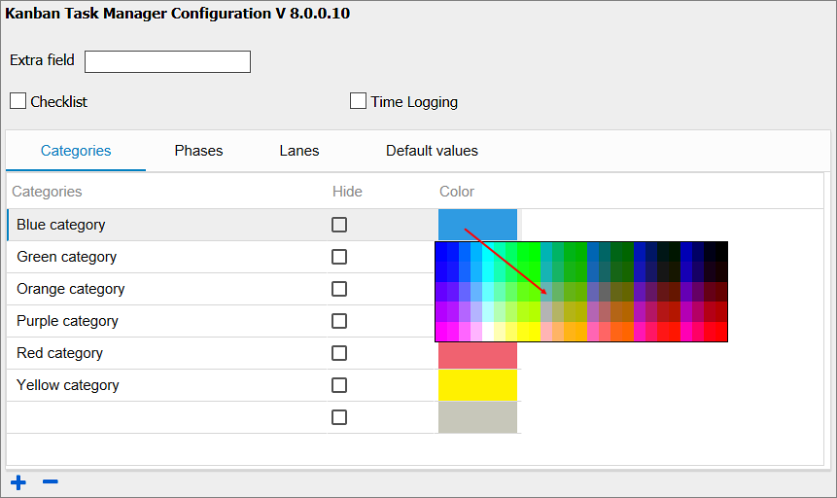
Kanban Task Manager – Coloring
Click on a color to change it.
www.bizsolutions365.com
Kanban Task Manager Single supports Microsoft Office 2010 and above

Slide 11
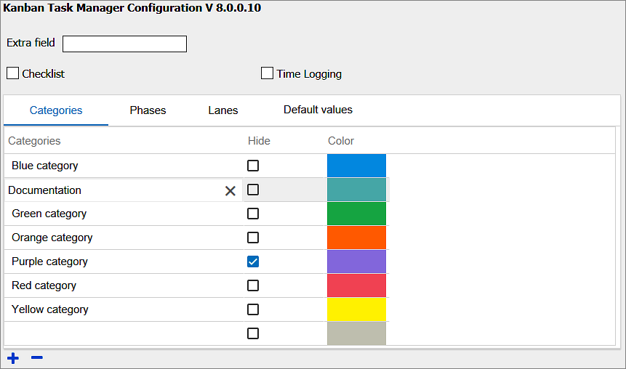
Kanban Task Manager – Categories Settings
Write or paste into the grid.
Hide categories from the kanban board.
www.bizsolutions365.com
Kanban Task Manager Single supports Microsoft Office 2010 and above

Slide 12
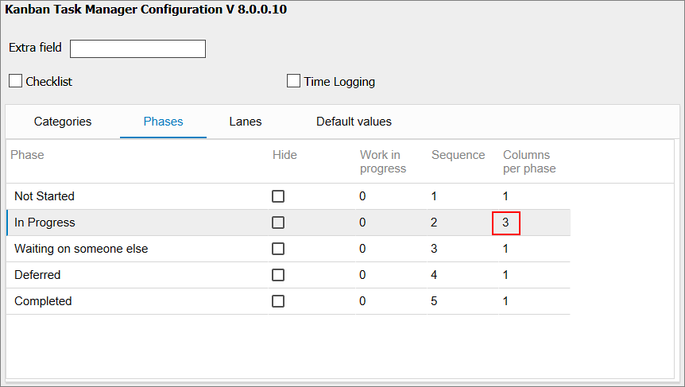
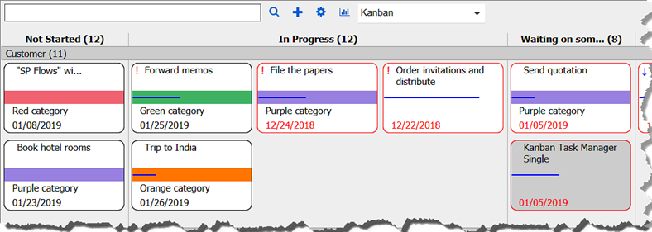
Kanban Task Manager – Phase Settings
Three columns of task cards in the In Progress phase.
Set the number of task columns in the phase.
Hide a phase from the kanban board.
www.bizsolutions365.com
Kanban Task Manager Single supports Microsoft Office 2010 and above

Slide 13
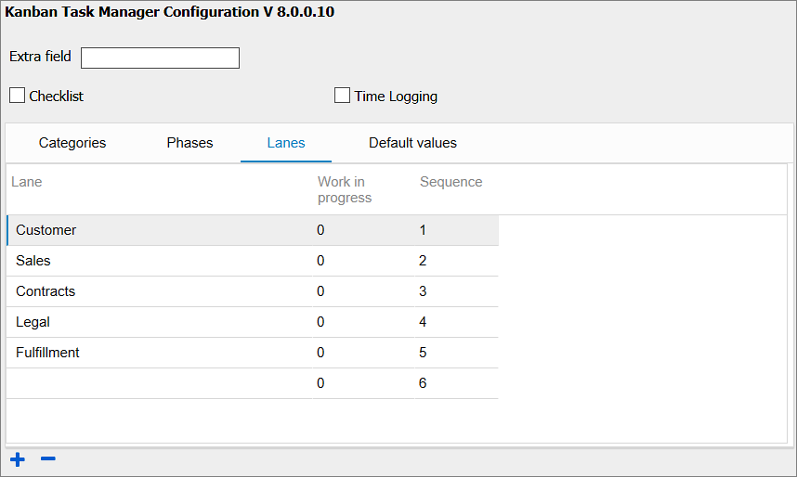
Kanban Task Manager – Lane Settings
Define the order of the lanes, from top to bottom.
Write or paste the lane names here. If you prefer to NOT use lanes, just leave this grid empty.
www.bizsolutions365.com
Kanban Task Manager Single supports Microsoft Office 2010 and above

Slide 14
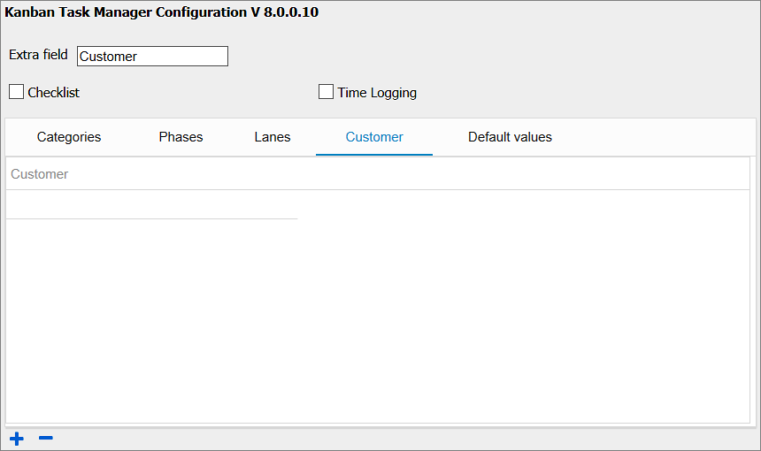
Kanban Task Manager – Custom Field
When a name is entered for an extra field, a new tab will be shown, where you can add the values for your custom parameter.
www.bizsolutions365.com
Kanban Task Manager Single supports Microsoft Office 2010 and above

Slide 15
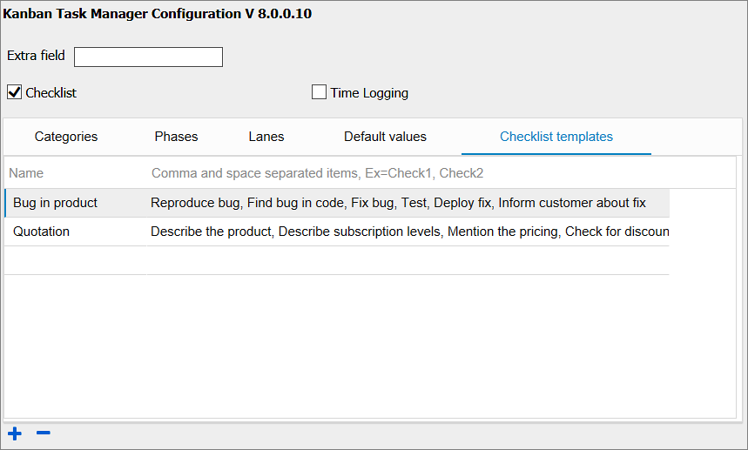
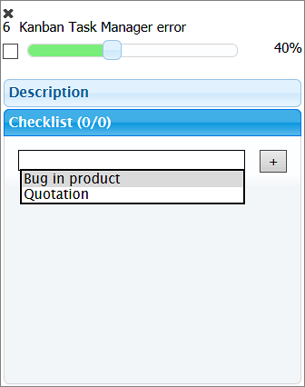
Kanban Task Manager – Checklist templates
Checklist templates can be managed under the details pane.
If the ‘Checklist’ feature is enabled, then there will be another tab called ‘Checklist templates’. If many tasks have the same steps to be performed, you can create a template for the checklist steps under the ‘Checklist templates’ tab.
Configuration
Details Pane
www.bizsolutions365.com
Kanban Task Manager Single supports Microsoft Office 2010 and above

Slide 16
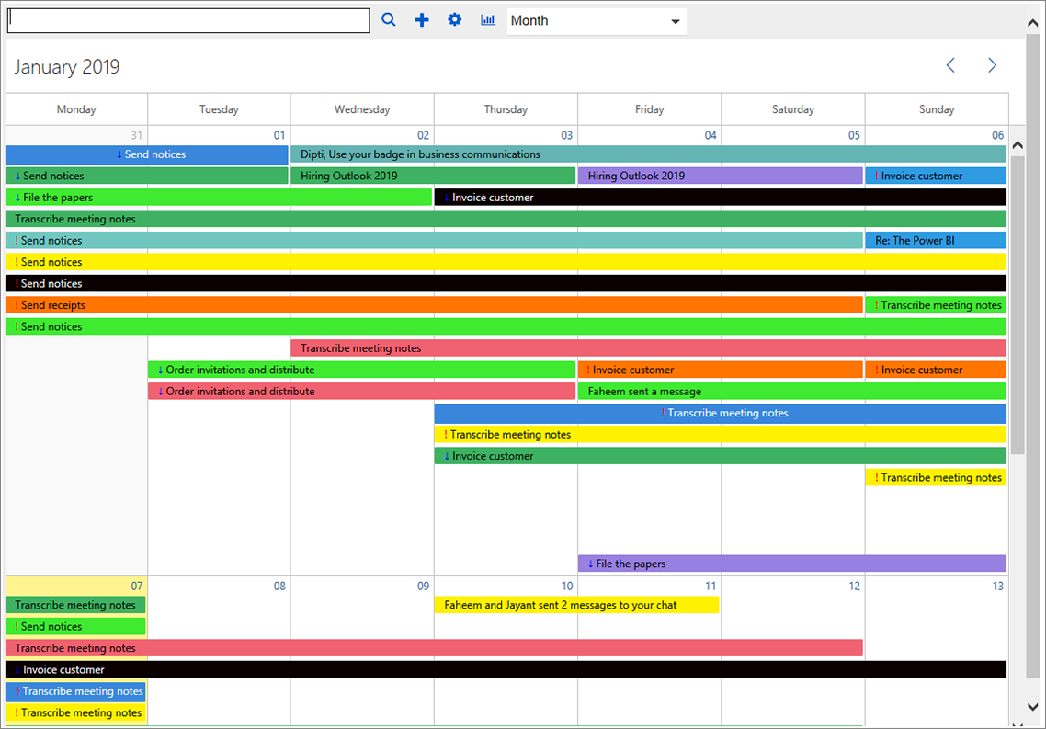
Kanban Task Manager – Month View
Select another month.
www.bizsolutions365.com
Kanban Task Manager Single supports Microsoft Office 2010 and above

Slide 17
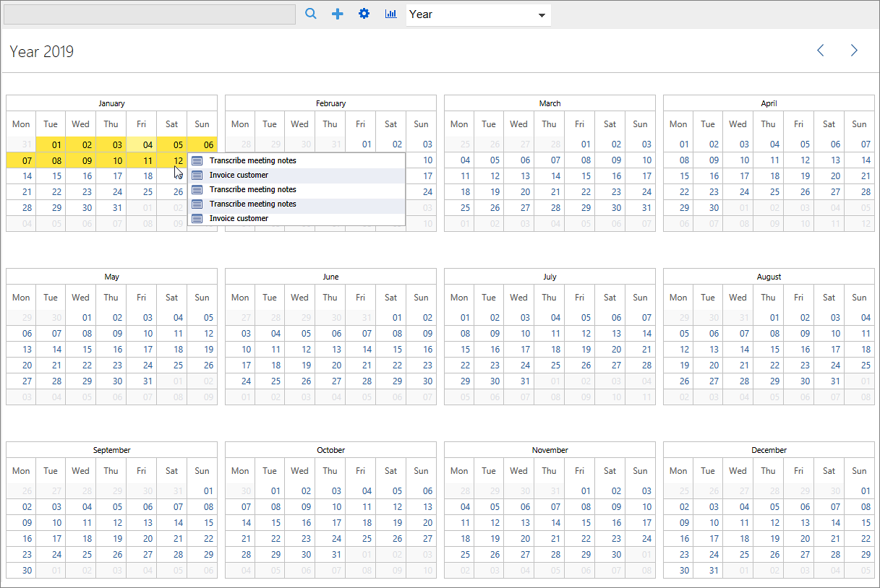
Kanban Task Manager – Year View
Highlighted dates have tasks.
www.bizsolutions365.com
Kanban Task Manager Single supports Microsoft Office 2010 and above

Slide 18
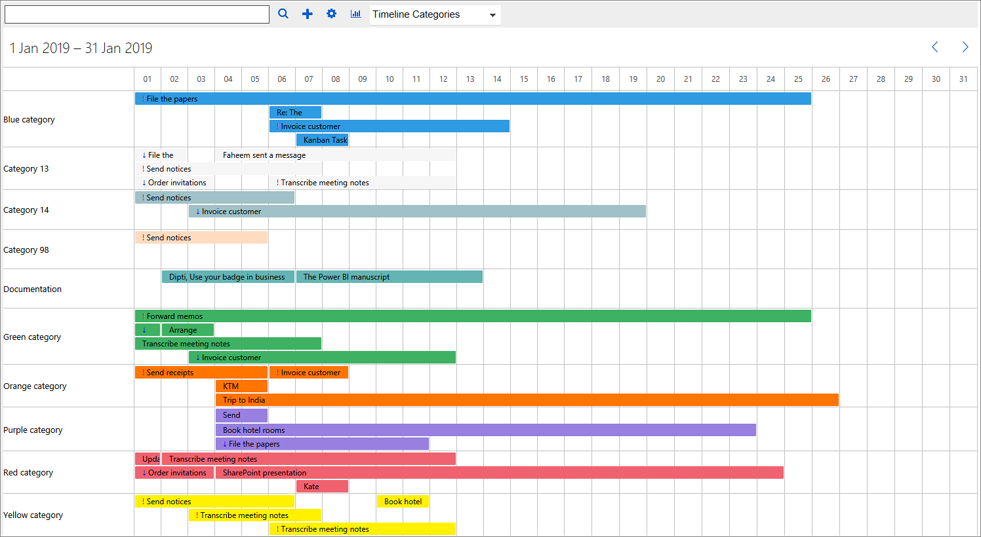
Kanban Task Manager – Timeline grouped by Categories
Drag to change start or due time.
www.bizsolutions365.com
Kanban Task Manager Single supports Microsoft Office 2010 and above

Slide 19
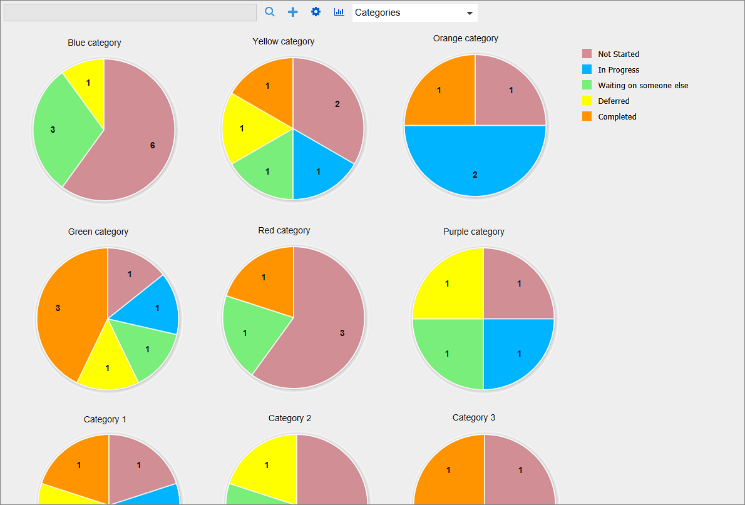
Kanban Task Manager – Categories View
Each category is visualized as a pie chart.
This phase has three tasks.
www.bizsolutions365.com
Kanban Task Manager Single supports Microsoft Office 2010 and above

Slide 20
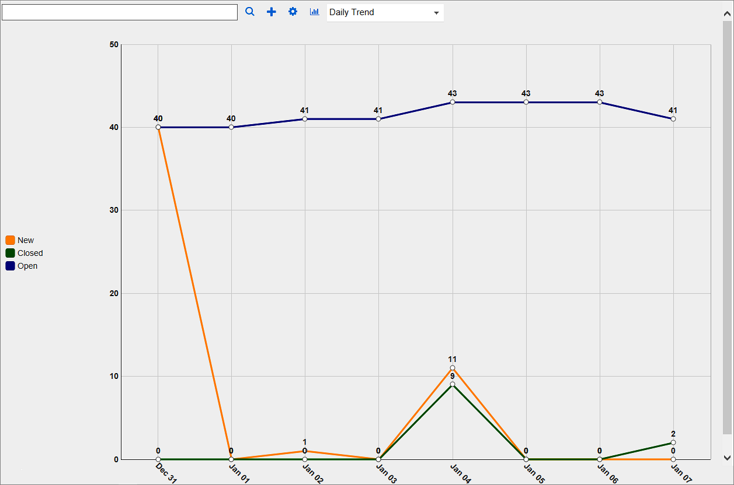
Kanban Task Manager – Daily Trend
Display task statuses in a line chart.
www.bizsolutions365.com
Kanban Task Manager Single supports Microsoft Office 2010 and above

Slide 21
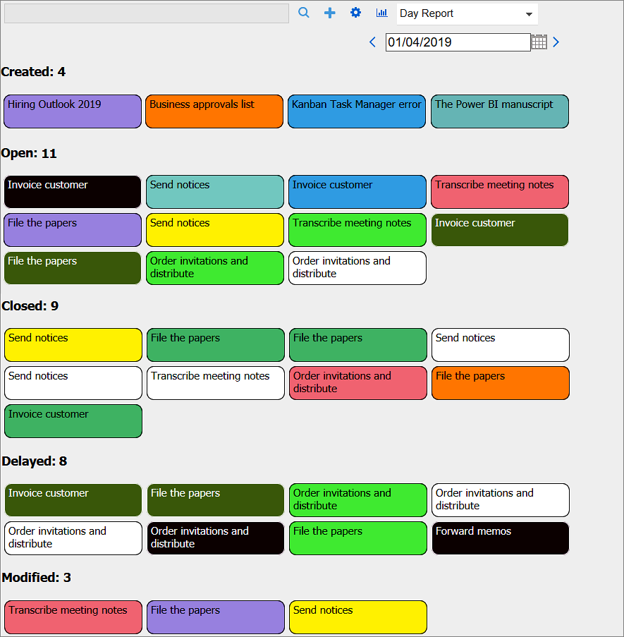
Kanban Task Manager – Daily Report
Tasks that were created, open, closed, delayed or modified on a specified date.
Select a date
www.bizsolutions365.com
Kanban Task Manager Single supports Microsoft Office 2010 and above

Slide 22
Kanban Task Manager – Export to Excel
Kanban Task Manager gives several statistics reports that are exported to an Excel sheet:
Number of Tasks per Category
Number of Tasks per Phase
Tasks per Lane and Phase
Average of Tasks % Completed per Phase
When lanes are used, there are three additional default reports:
Number of Tasks per Lane
Tasks per Phase and Lane
Average of Tasks % Completed Task per Lane
When time logging is used, there are reports of hours per task, phase and category, and when a custom field is used, there is a report on the number of tasks for each value of that field.
www.bizsolutions365.com
Kanban Task Manager Single supports Microsoft Office 2010 and above

Slide 23
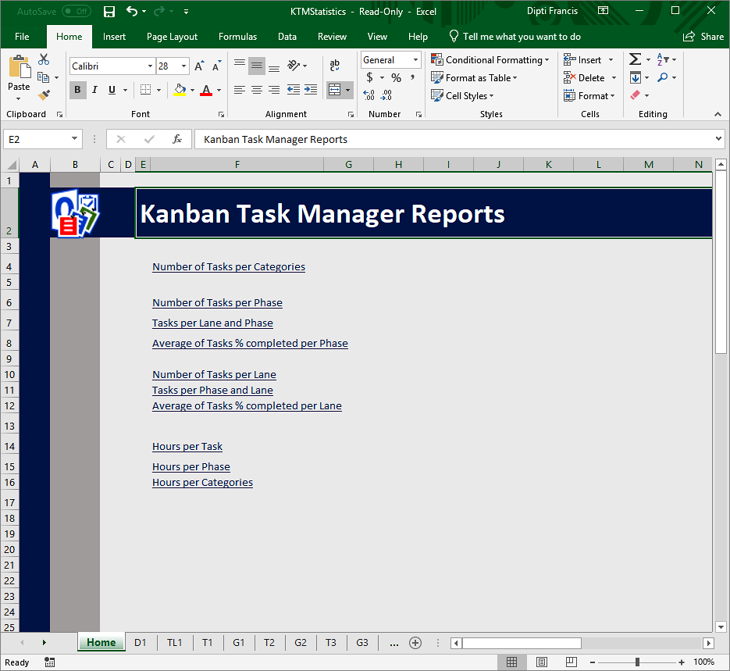
Kanban Task Manager – Excel Reports
Links to reports.
Pivot and graph representations of the reports.
www.bizsolutions365.com
Kanban Task Manager Single supports Microsoft Office 2010 and above

Slide 24
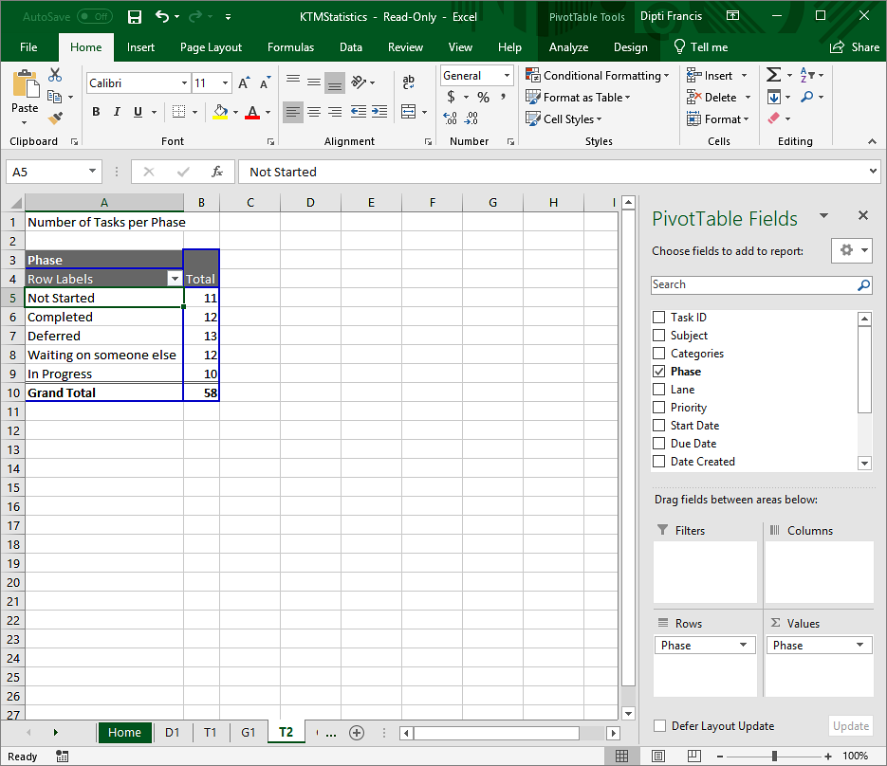
Kanban Task Manager Excel Reports – Pivot Table
You may sort, filter, drill and add more fields for extended info.
www.bizsolutions365.com
Kanban Task Manager Single supports Microsoft Office 2010 and above

Slide 25
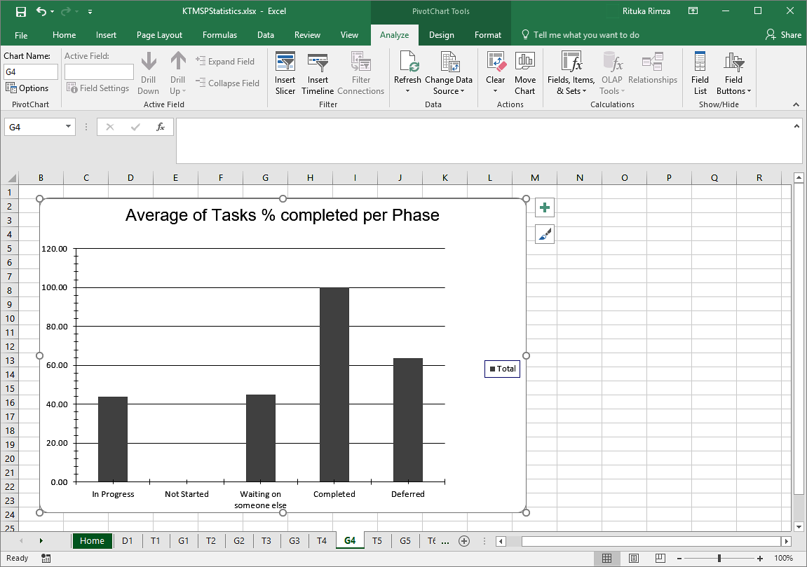
Kanban Task Manager Excel Reports – Default Graph Style
The reports may be printed, saved as .pdf and studied with all the features of Excel.
Each report also has a graph presentation. Changes in the pivot will be reflected in the graph and vice versa.
www.bizsolutions365.com
Kanban Task Manager Single supports Microsoft Office 2010 and above

Slide 26
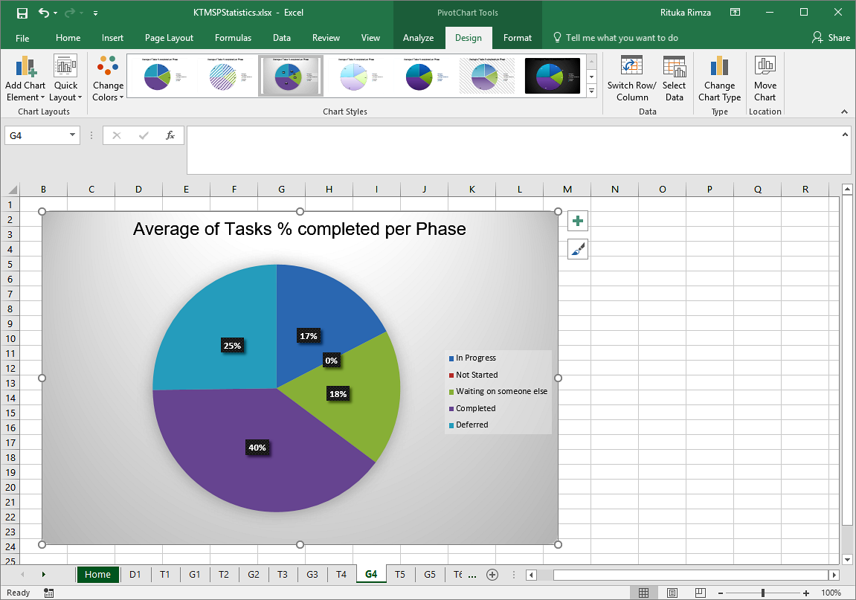
Kanban Task Manager Excel Reports – Custom Graph Style
Change the graphs as you like with the Excel tools.
www.bizsolutions365.com
Kanban Task Manager Single supports Microsoft Office 2010 and above

Slide 27
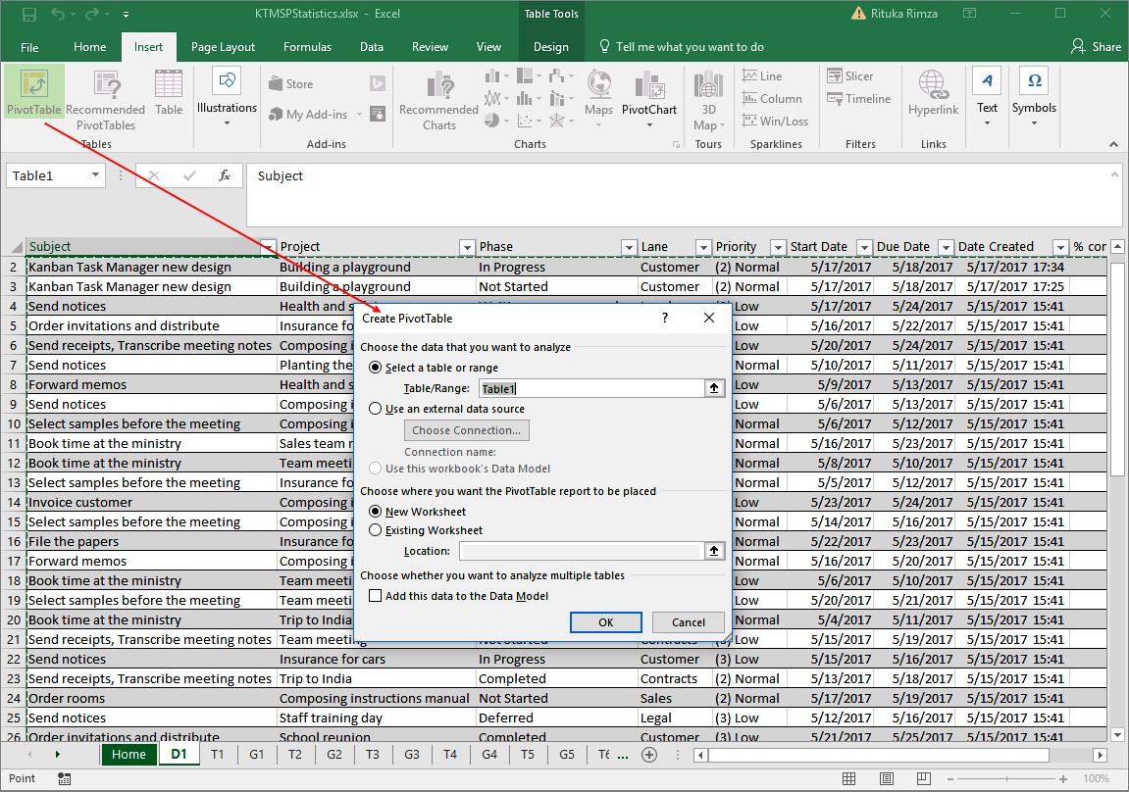
Kanban Task Manager Excel Reports – Custom Reports
The first tab shows all the task data in the database. Use it to create your own reports.
www.bizsolutions365.com
Kanban Task Manager Single supports Microsoft Office 2010 and above

Slide 28
Kanban Task Manager Single – More info
Thank you for watching this slide show! You will find https://bizsolutions365.com/our-products/kanban-task-manager/.
There you may download the full version of the software and evaluate it for 30 days before you decide if you want to use it.
We recommend you to also download the manual, which has detailed information about settings, configuration and usage and a full description of how to install and upgrade Kanban Task Manager Single.
On the bizsolutions365.com website you will also find video demonstrations on Kanban Task Manager Single, as well as subscription information.
www.bizsolutions365.com
Kanban Task Manager Single supports Microsoft Office 2010 and above

