Slide 1
E-mail Converter converts Outlook e-mails to SharePoint list items E-mail Converter creates SharePoint list items from Outlook
E-mail Converter for Outlook and SharePoint
www.bizsolutions365.com
E-mail Converter supports Office 2010 and SharePoint 2010 above

Slide 2
E-mail Converter for Outlook and SharePoint - Introduction
Welcome to this slideshow presentation of E-mail Converter, an Outlook add-in that publishes e-mails to SharePoint or creates new SharePoint list items from Outlook. It is often used for cooperation on issue tracking and user support. E-mail Converter is built on Microsoft Outlook and SharePoint, which gives this application superior qualities when it comes to features and customization possibilities. It also makes E-mail Converter very easy to use and configure.
I will start with showing you a default SharePoint list, and then I will explain how E-mail Converter connects Outlook and SharePoint and thereby enhances both products.
Finally I will inform about the integrated statistics and reporting tool.
www.bizsolutions365.com
E-mail Converter supports Office 2010 and SharePoint 2010 above

Slide 3
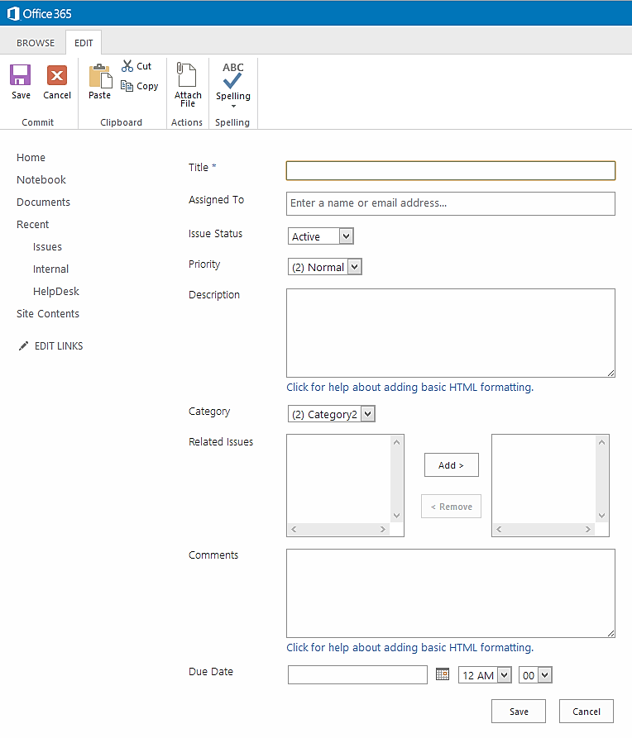
Standard SharePoint list ites
This item is from a SharePoint list that is NOT connected to E-mail Converter. There are endless possibilities to customize the lists, but there is NO connection to Outlook.
www.bizsolutions365.com
E-mail Converter supports Office 2010 and SharePoint 2010 above

Slide 4
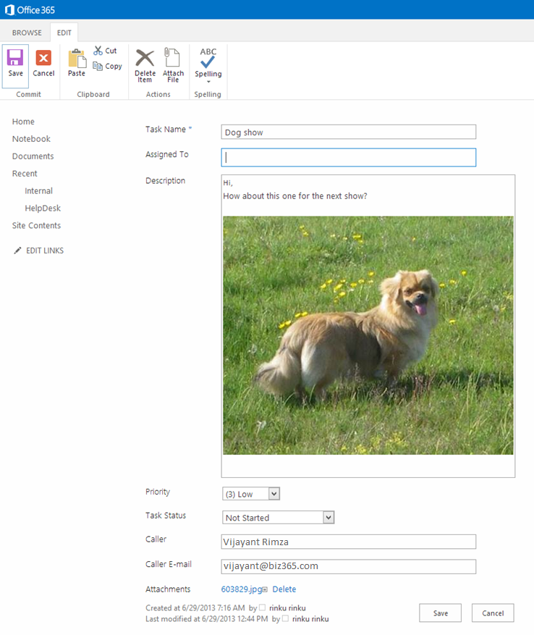
Ticket example, SharePoint list connected to Outlook
For E-mail Converter you can use the SharePoint Task list, the Issue tracking list or any other list that suits your needs.
This item is from a SharePoint list connected to Outlook with E-mail Converter.
Formatting, links, attachments and embedded images are transferred from the e-mail.
www.bizsolutions365.com
E-mail Converter supports Office 2010 and SharePoint 2010 above

Slide 5
E-mail Converter Configure dialog in Outlook Main Screen
The Settings are done by the admin on one machine. All subsequent users who select the same site will get the same lists and settings.
www.bizsolutions365.com
E-mail Converter supports Office 2010 and SharePoint 2010 above

Slide 6
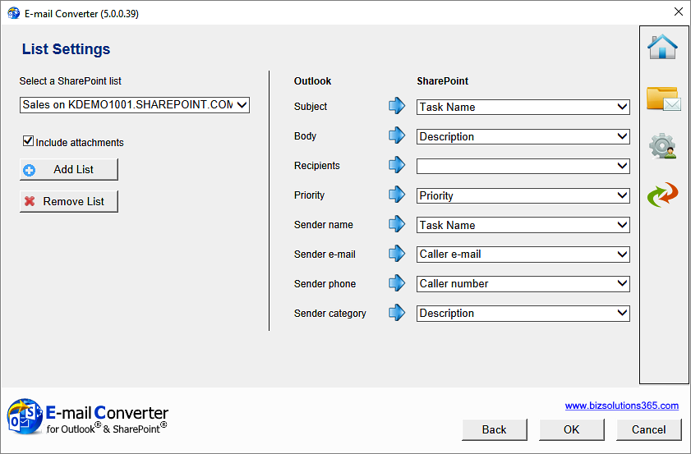
Defines the connection between Outlook and SharePoint
E-mail Converter Configure dialog in Outlook List Settings
Define where the different e-mail parts should be entered in the SharePoint list items. The dropdowns will be populated with the columns in the selected SharePoint list.
Select which of the lists on the SharePoint site that should be used with E-mail Converter. Several lists can be used.
www.bizsolutions365.com
E-mail Converter supports Office 2010 and SharePoint 2010 above

Slide 7
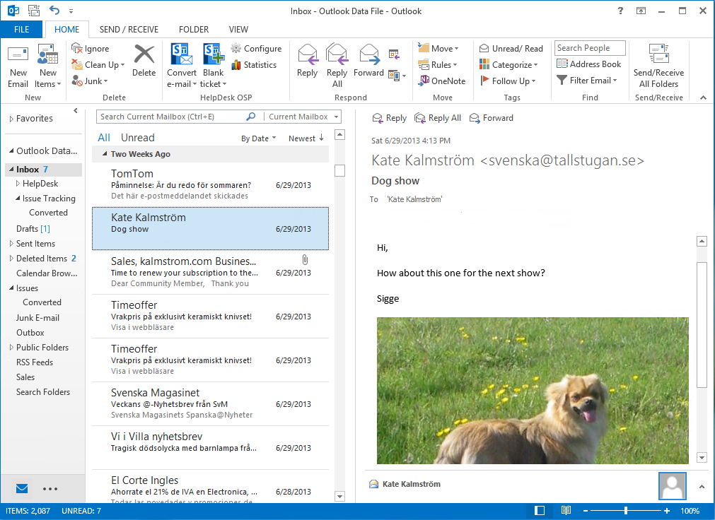
E-mail Converter – Create newticket from e-mail
When you use several SharePoint lists with E-mail Converter, you may easily distribute converted e-mails and new tickets to different SharePoint lists.
Use ”Convert” if you want to convert an e-mail into a ticket manually.
www.bizsolutions365.com
E-mail Converter supports Office 2010 and SharePoint 2010 above

Slide 8
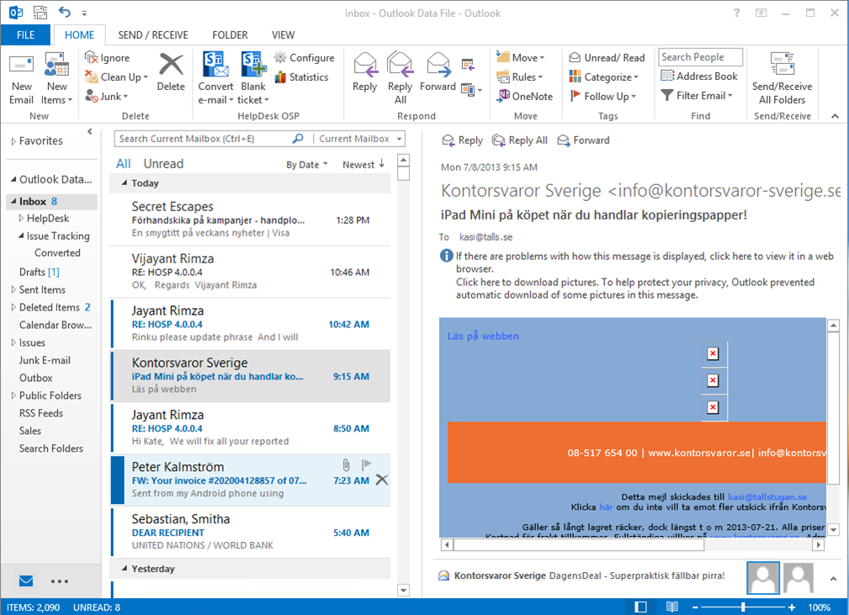
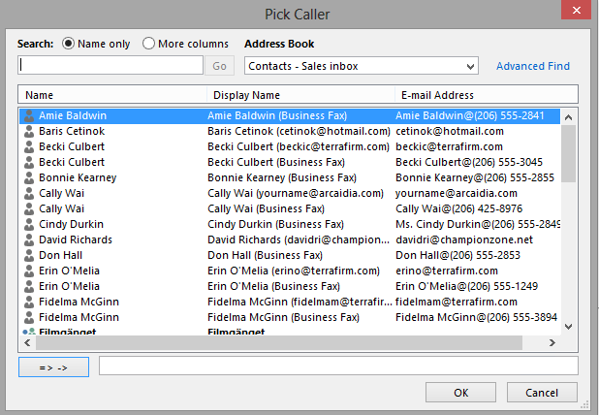
E-mail Converter – Blank ticket Pick caller from Contacts or GAL
Use ”Blank ticket” when information from a telephone report needs to be entered into a ticket ‒ or just when you wish to publish something to SharePoint without leaving Outlook.
If the caller is in your Contacts or Global Address List, you can pick her/him from there. The details will be automatically entered into the ticket.
www.bizsolutions365.com
E-mail Converter supports Office 2010 and SharePoint 2010 above

Slide 9
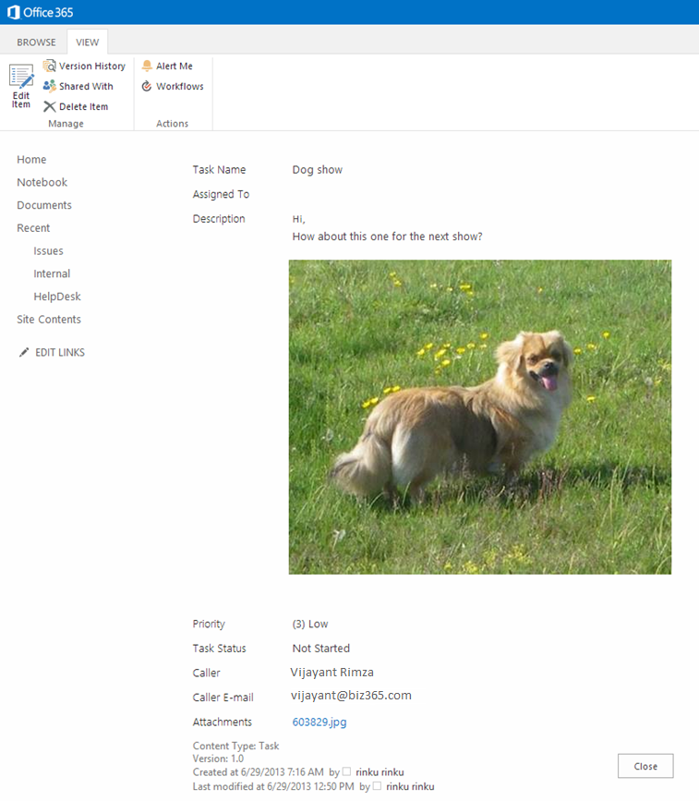
E-mail Converter – E-mail has been converted into a ticket
The ticket is automatically filled out with the information from the e-mail, according to the configuration.
E-mail Converter works with all SharePoint lists, so you can customize the list to suit your organization.
www.bizsolutions365.com
E-mail Converter supports Office 2010 and SharePoint 2010 above

Slide 10
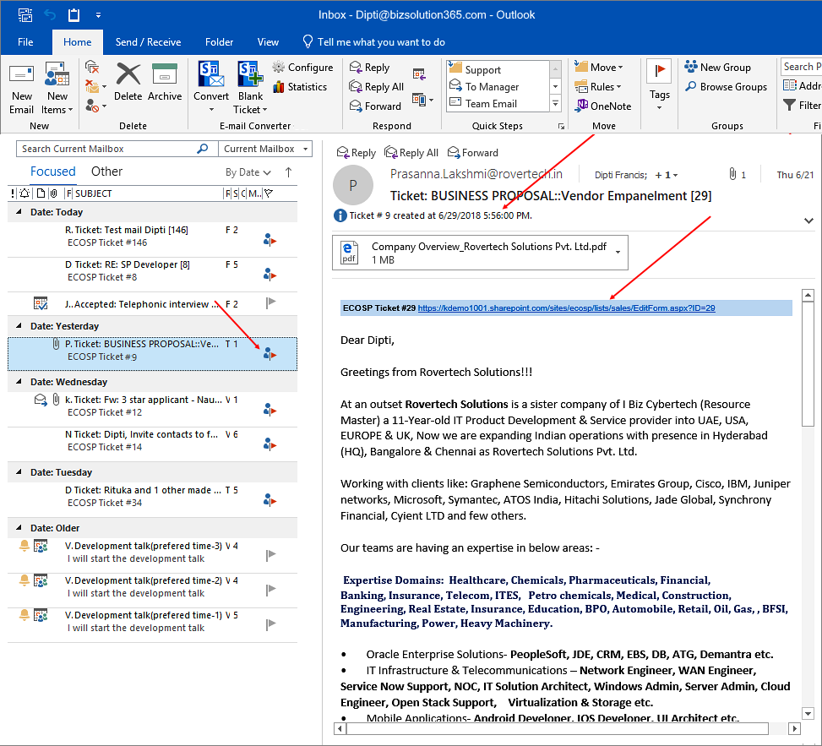
E-mail Converter – E-mail has been converted into a ticket
When an e-mail has been converted into a ticket, the e-mail is marked with ticket ID and date and time for conversion. The path to the ticket can also be added.
The converted e-mail will have a ticket URL, if you have enabled ‘Embed ticket URL in e-mail’ in the General Settings
The icon and the ticket ID shows that the e-mail has been converted into a list item
www.bizsolutions365.com
E-mail Converter supports Office 2010 and SharePoint 2010 above

Slide 11
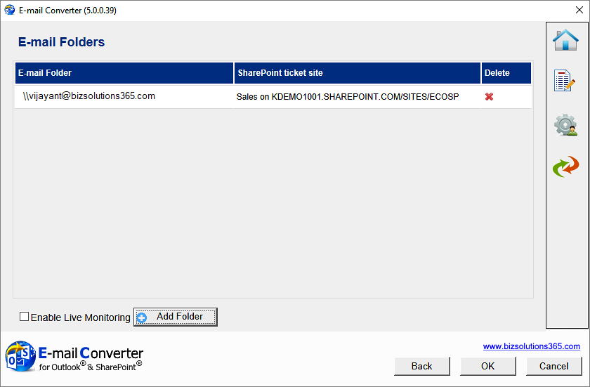
E-mail Converter Automatic e-mail conversion
If you monitor several folders, select one SharePoint list for each folder and let E-mail Converter automatically distribute the incoming mail.
Check this box for automatic e-mail conversion.
Add a Public folder or Mailbox.
www.bizsolutions365.com
E-mail Converter supports Office 2010 and SharePoint 2010 above

Slide 12
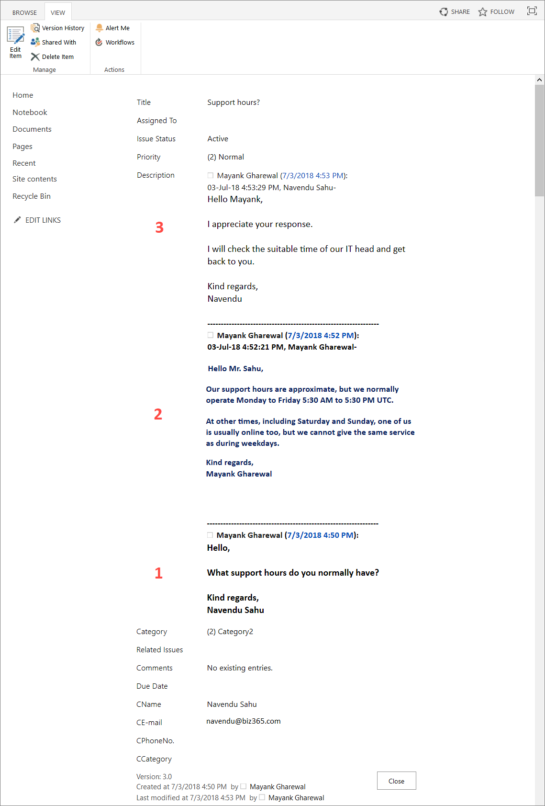
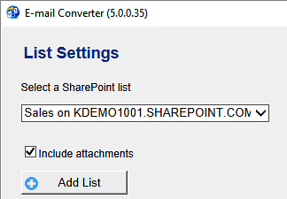
E-mail Converter – E-mail Threading
All e-mails about the same case will be gathered in the same ticket if you...
… check this box in the General Settings dialog …
… and select list and column for the e-mail thread in the List Settings dialog.
The image shows the order of entries when you use the Description field for both the first e-mail and the threading field.
When you use the E-mail Threading feature, E-mail Converter adds the ticket ID in the Subject of the e-mail, to identify its SharePoint item ID.
www.bizsolutions365.com
E-mail Converter supports Office 2010 and SharePoint 2010 above

Slide 13
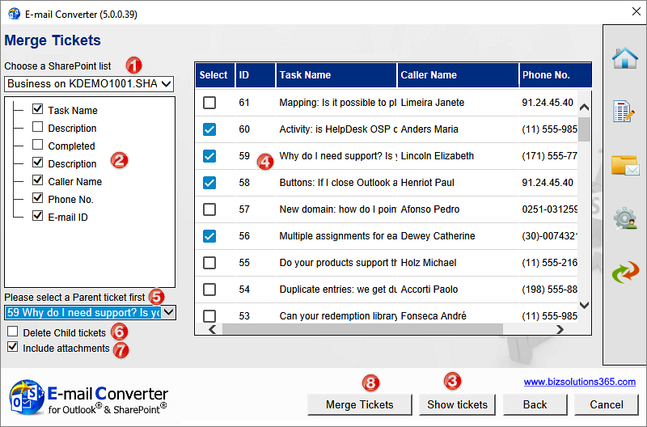
E-mail Converter – Merge Tickets
1. Select list and fields to merge
3. Select tickets to merge
4. Select Parent Ticket
2. Show the tickets in the selected list.
www.bizsolutions365.com
E-mail Converter supports Office 2010 and SharePoint 2010 above

Slide 14
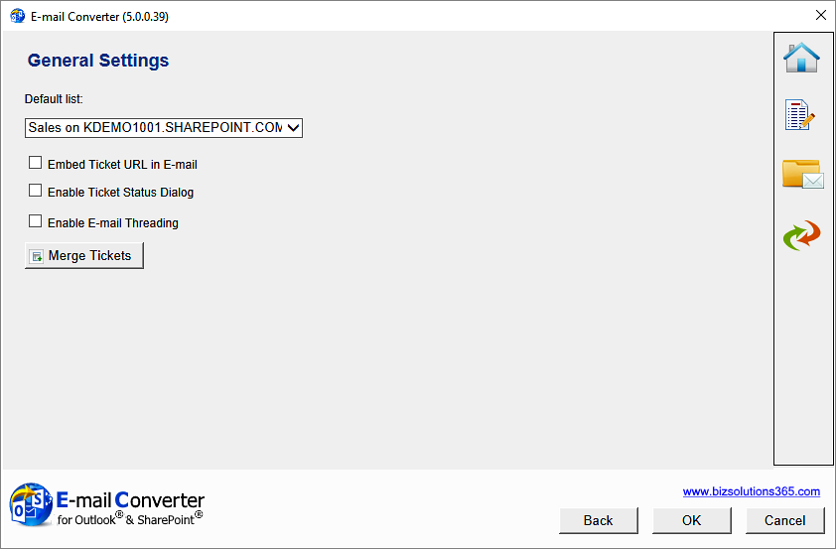
E-mail Converter – the General Settings dialog gives more possibilities
Select default list for manual conversion
www.bizsolutions365.com
E-mail Converter supports Office 2010 and SharePoint 2010 above

Slide 15
E-mail Converter Repoet
The E-mail Converter report is useful for managers who want to see what kind of problems are reported, how problem solving time is distributed, what problems different staff has been working with etc. The report can be reached from the E-mail Converter toolbar in Outlook.
www.bizsolutions365.com
E-mail Converter supports Office 2010 and SharePoint 2010 above

Slide 16
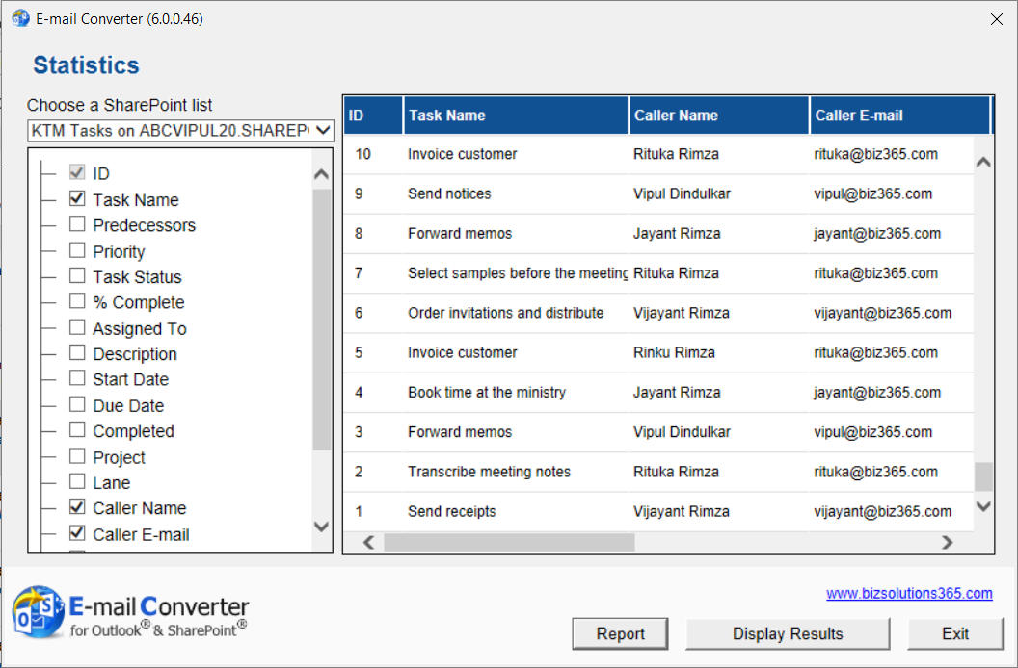
E-mail Converter Repoet – Select SharePoint fields to study
Select SharePoint list and the fields you want to analyze.
Click on the Report button to see the data in Excel, where you can manipulate it with all the standard Excel tools.
www.bizsolutions365.com
E-mail Converter supports Office 2010 and SharePoint 2010 above

Slide 17
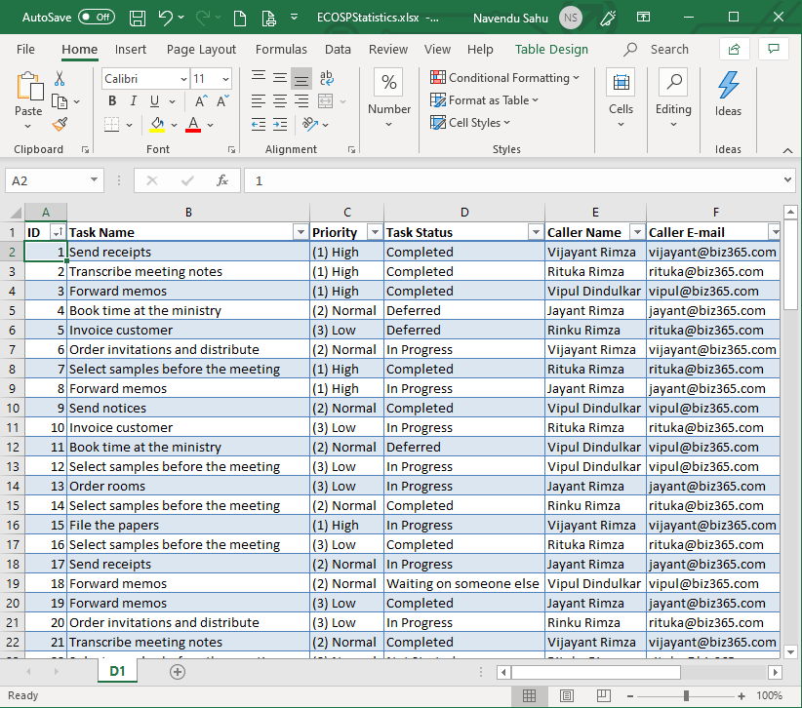
E-mail Converter Repoet – The Excel report
www.bizsolutions365.com
E-mail Converter supports Office 2010 and SharePoint 2010 above

Slide 18
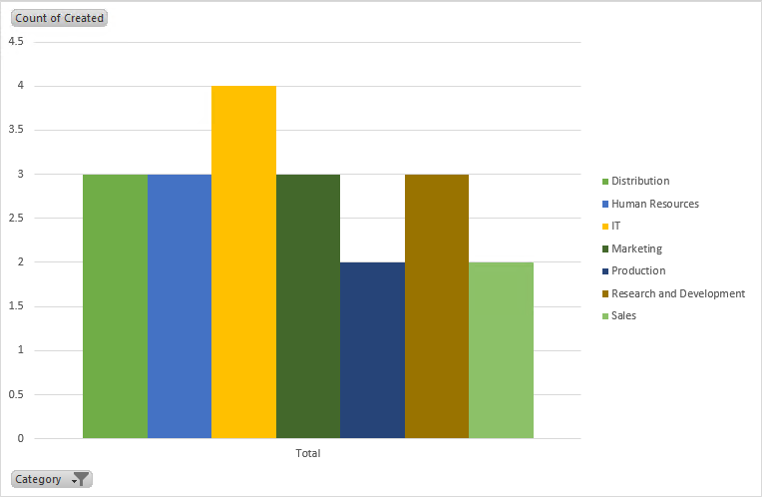
E-mail Converter Repoet - Data used in graph
The caller departments and created dates have been combined in a graph that shows number of tickets created for each department during a selected period.
www.bizsolutions365.com
E-mail Converter supports Office 2010 and SharePoint 2010 above

Slide 19
E-mail Converter More info
Thank you for watching this slide show! You will find more information about E-mail Converter on the bizsolutions365.com website.
There you can also download the latest version of the software and try it for 30 days without any obligations.
You are welcome to visit http://bizsolutions365.com/ and learn more!
www.bizsolutions365.com
E-mail Converter supports Office 2010 and SharePoint 2010 above

